Slide 1
SOFTWARE DESIGN AND ARCHITECTURE
(PRACTICAL #06)
CREATIONAL DESIGN PATTERNS (SINGLETON)

Slide 2
SINGLETON DESIGN PATTERN

Slide 3
SINGLETON Pattern: Intent and Motivation
Intent: Ensure a class only has one instance, and provide a global point of access to it.
Motivation: In many systems, there should often only be one object instance for a given class
Print spooler
File system
Window manager
one Input/Output socket
How do we ensure that a class has only one instance and that the instance is easily accessible?
Global variable makes an object accessible, but multiple instances
Class itself responsible for sole instance.
Notes:
Spool is an acronym for simultaneous peripheral operations on-line.

Slide 4
CREATING A SINGLE INSTANCE
This maybe necessary because:
More than one instance will result in incorrect program behavior
More than one instance will result in the overuse of resources
There is a need for a global point of access

Slide 5
SINGLETON Pattern: Applicability
Applicability:
Use the Singleton pattern when
there must be exactly one instance of a class, and it must be accessible to clients from a well-known access point

Slide 6
SINGLETON Pattern: Structure
Singleton
static uniqueInstance
singletonData
static instance()
singletonOperation()
return uniqueInstance
getSingletonData()

Slide 7
SINGLETON Pattern: Participants & Collaboration
Participants:
Singleton
defines an instance() operation that lets clients access its unique instance.
Instance is a class operation (i.e.: static)
may be responsible for creating its own unique instance
Collaboration:
Clients access a Singleton instance solely through Singleton's Instance operation.

Slide 8
SINGLETON Pattern: Consequences
Controlled access to sole instance
As the constructor is private, the class controls when an instance is created
Reduced name space
Eliminates the need for global variables that store single instances
Permits a variable number of instances
The class is easily modified to allow n instances when n is not 1

Slide 9
SINGLETON PATTERN: Implementation
class Singleton
{
private static Singleton instance = null;
private Singleton() { }
public static Singleton getInstance() {
if(instance == null)
{
instance = new Singleton();
}
return instance;
}
public static void main(String args[]){
Singleton s=getInstance();
System.out.println("one="+s);
Singleton s2=getInstance();
System.out.println("one="+s2);
}
}

Slide 10
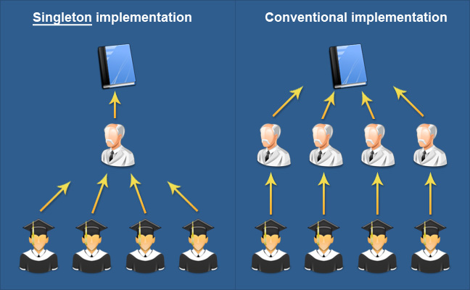
EASY LOOK

Slide 11
Singleton Pattern: Known Use & Related Patterns
Known use: A known use for singleton pattern is where a global resource is shared, Also used with meta classes.
Related Patterns: Many patterns can be implemented using the Singleton pattern. Abstract Factory, Builder, Prototype.

Slide 12
EXAMPLES
Example 1 - Logger Classes
The Singleton pattern is used in the design of logger classes. This classes are usually implemented as a singletons, and provides a global logging access point in all the application components without being necessary to create an object each time a logging operations is performed.
Example 2 - Configuration Classes
The Singleton pattern is used to design the classes which provides the configuration settings for an application. By implementing configuration classes as Singleton not only that we provide a global access point, but we also keep the instance we use as a cache object. When the class is instantiated( or when a value is read ) the singleton will keep the values in its internal structure. If the values are read from the database or from files this avoids the reloading the values each time the configuration parameters are used.

Slide 13
TASK FOR PRACTICAL#06
Implement the singleton pattern in a class which returns database connections to the clients.

Slide 14
READ MORE
For those who are interested, they can explore more about this pattern on the internet. ☺

